Slide 1
Data Augmentation
For Tabular Data
Krunal Patel (0864443)
Guidance By: Prof. Yimin Yang

Slide 2
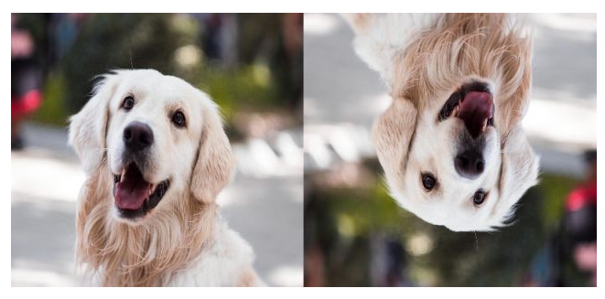
How augmentation works on images
How can it be applied and implemented on tabular data?

Slide 3
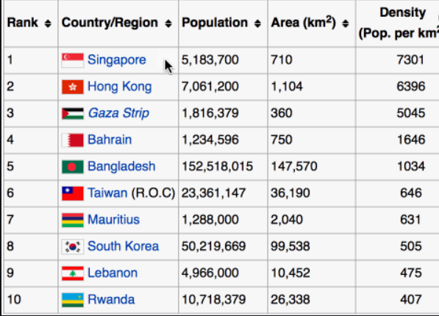
Fake data

Slide 4
Approaches
Noisy copies on AUTOELM
Using beta values from AUTOELM
Generative Adversarial Network
GAN + AUTOELM

Slide 5
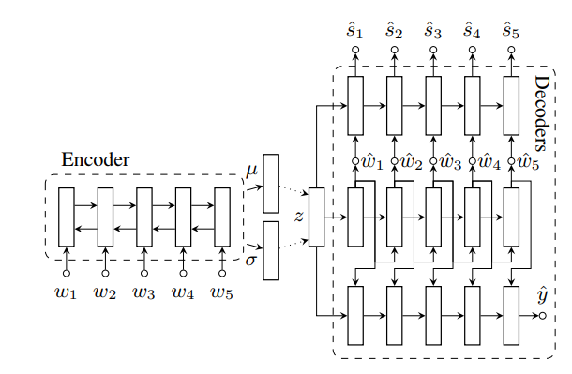
Data Augmentation for Spoken Language Understanding via Joint Variational Generation
Kang Min Yoo, Youhyun Shin, Sang-goo Lee
Deep generative model and text generation
Data Augmentation and regularization
Generative data augmentation

Slide 6
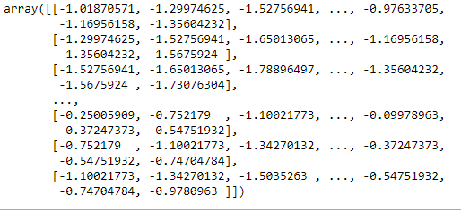
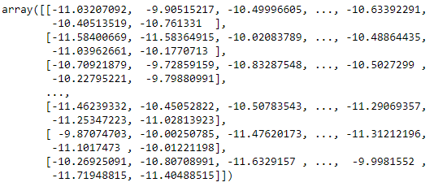
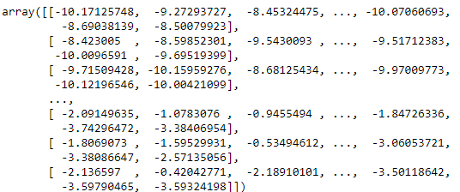
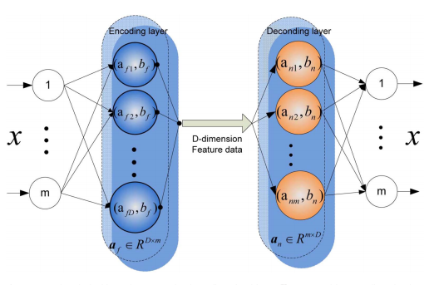
Using random noise
Time embedded matrix
Random values (noise)
Augmented Data
Undergoes training

Slide 7
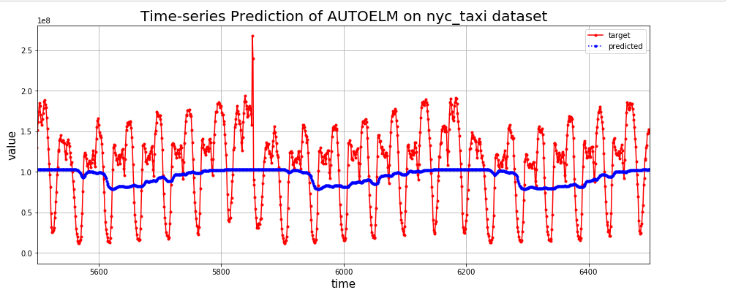
Original data : 17520
Generated : 720000
Time taken : 7 minutes
Applied AUTOELM on augmented data
NRMSE : 5.1282

Slide 8
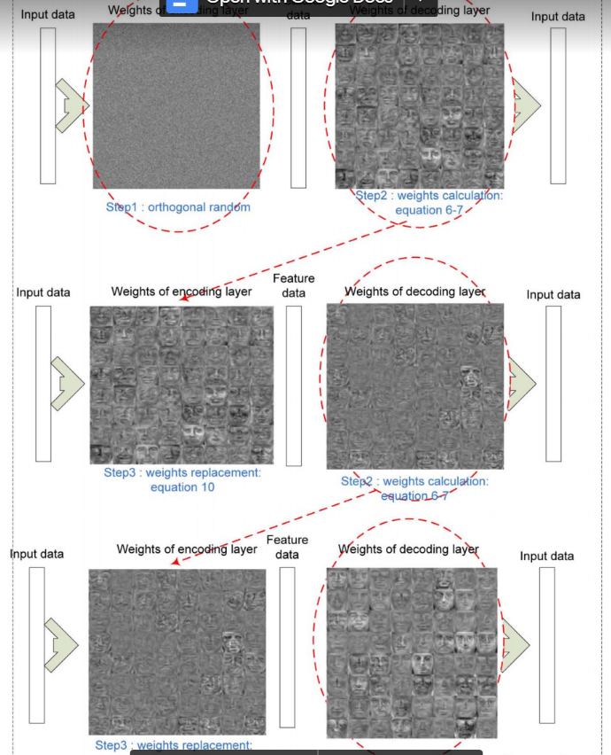
AUTOELM - base algorithm
Autoencoder With Invertible Functions for Dimension Reduction and Image Reconstruction
Yimin Yang, Jonathan Wu, Yoanan Wang

Slide 9

Using beta values
AUTOELM
Time Embedded Matrix
Sequential phase
Beta weight calculated
Subtracted X 50 copies
Augmented Data
Undergoes training

Slide 10
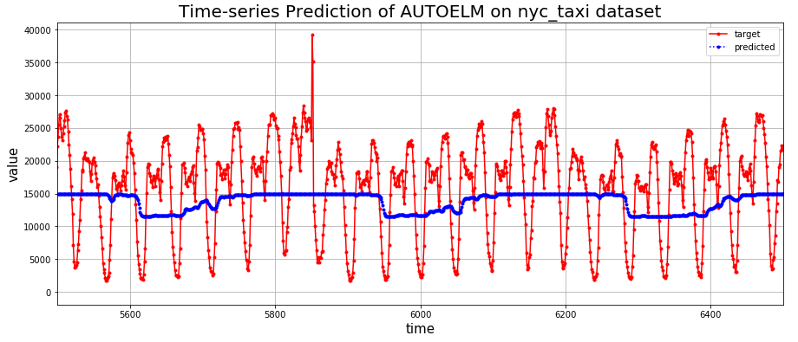
Original Data : 17520
Generated sample size : 7,20,000
NRMSE : 4.7782
Applied Feature extraction
PCA / LDA
NRMSE : 4.7042 / 4.7039

Slide 11
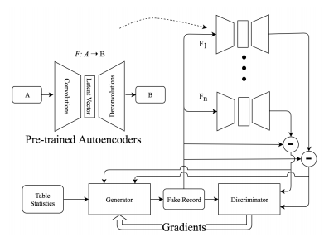
Paper Followed for GAN
FakeTables: Using GANs to Generate Functional Dependency Preserving Tables with Bounded Real Data
Haipeng Chen1∗ , Sushil Jajodia2 , Jing Liu2 , Noseong Park2∗ , Vadim Sokolov2 and V. S. Subrahmanian1
Introduced : ITS-GAN

Slide 12
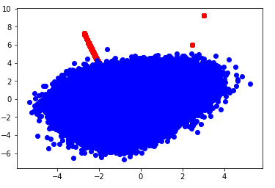
GAN
Time Embedded Matrix
X = (X’ , X’^2)
Data = ( X , 1 )
Marked as Real Data
Discriminator
Loss
Random points generation
Generator
Data = ( R , 0 )
Marked as Fake Data

Slide 13
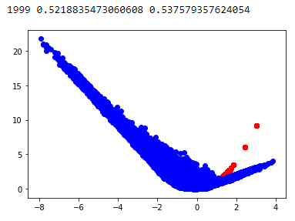
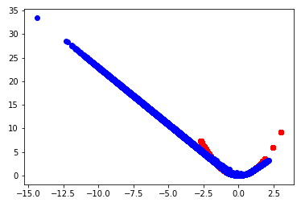
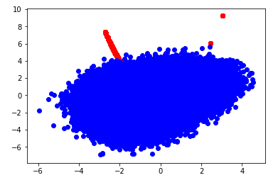
Dataset : Nyc_taxi
Uses backpropagation
Time taken : 36 hours
RTX 2080 - 6 gb
Training generator model (17,52,000 fake samples)
NRMSE : 2.657

Slide 14
GAN_AUTOELM
Time Embedded Matrix
X = (X’ , X’^2)
Data = ( X , 1 )
Marked as Real Data
Discriminator
Loss
Random points generation
Time Embedded Matrix
AUTOELM
Sequential phase
Generator
Beta weight calculated
Data = ( R , 0 )
Marked as Fake Data
Subtracted X 50 copies

Slide 15
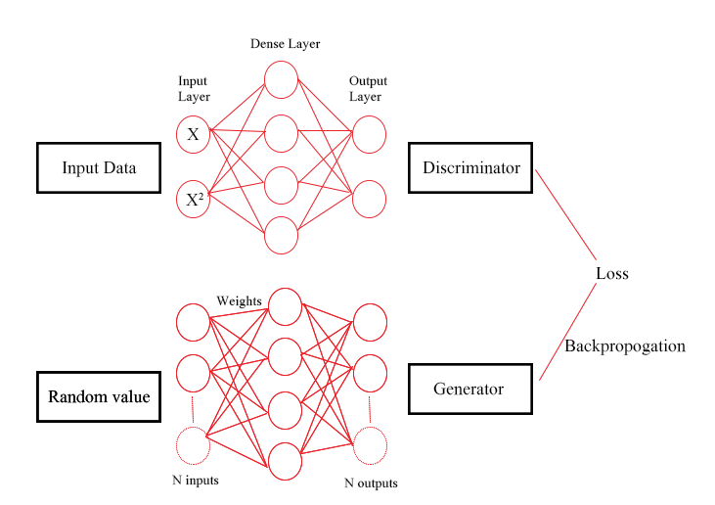


Half batch
Half batch

Slide 16


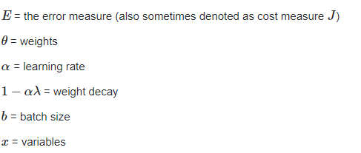
Error Minimization
Old weights
New weight
Weight updation formula
Beta Weight(sequential phase AUTOELM)

Slide 17
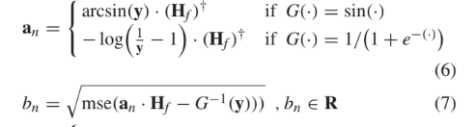

Slide 18
AUTOELM | Noisy copies | GAN | AUTOELM + GAN
4.7023 | 5.1282 | 2.657 | 3.564
MSE
6 mins 7 mins 36.4 hours 19.3 hours

Slide 19
GRU + AUTOELM

Slide 20
Thank you

Slide 21
Google Slides Link

